Slide 1
Week 12 Exercises: PIOTs
Glenn A. Aguilar-Hernandez
March 22, 2o22

Slide 2
Today’s agenda
Time | Activity
15.20 – 15.35 | Recap MRIO and Part 1: Introduction
15.35 – 15.55 | Questions 1, 2, 3 & 4
15.55 – 16.05 | Review Questions
16.05 – 16.20 | Break
16.20 – 16.25 | Part 2: Introduction
16.25 – 16.50 | Develop code
16.50 – 17.00 | Review code

Slide 3
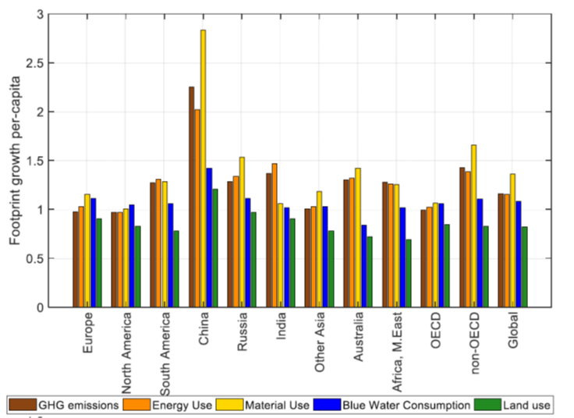
Recap MRIO
Figure 1. Growth in consumption-based footprints per capita between 1995 and 2011 for 11 world regions (1995 = 1) retrieved from Wood et al. (2018)

Slide 4
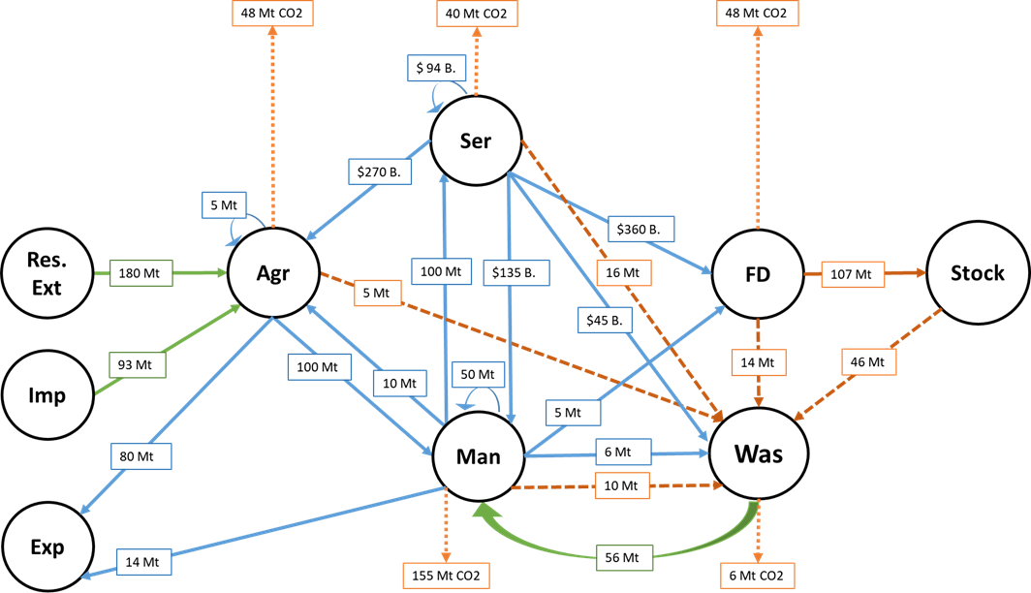
Part 1: Introduction
Figure 1. Diagram of inflows and outflows of the Dutch economy

Slide 5
Review Question 1,2, 3 & 4
Let’s go to the whiteboard!

Slide 6
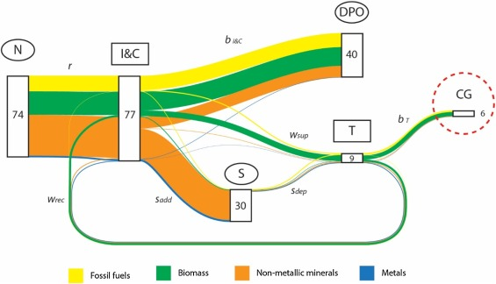
Part 2: Introduction
Figure 2. Sankey diagram of global material extraction, waste, and emission flows in 2011. Retrieved from Aguilar-Hernandez et al. (2019)

Slide 7
Review code
Let’s go to Jupyter Notebook!

